Slide 1






DATA SCIENCE – MINI PROJECT

Slide 2
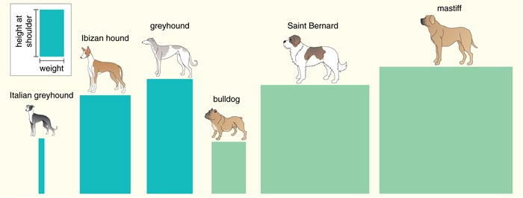
Most popular dog breeds

Slide 3

Guys do you like dogs and which breed you own.
Tell daa my dear friends…..

Slide 4

Content :
🐕🐩🐕‍🦺The most popular breeds distribution🐕🐩🐕‍🦺
🐕🐩🐕‍🦺Number of registrations of each breed🐕🐩🐕‍🦺
🐕🐩🐕‍🦺The number of registrations relative to the year🐕🐩🐕‍🦺
🐕🐩🐕‍🦺Year of registration🐕🐩🐕‍🦺
🐕🐩🐕‍🦺Correlations🐕🐩🐕‍🦺

Slide 5
Description :
Between 1915 and 1940, American Kennel Club statistics were collected on a five-year basis instead of every year. These figures show that between 1905 and 1935, the Siberian Husky was consistently in either first or second place. In 1925, following the popularity of Chow Chow, the Pit bull displaced the Chow as the top dog.
Malteses then led the way as the most popular dog from 1936 all the way through to 1952, when the Beagle became the number one dog until 1959.
Poodles would become the most popular breed for the longest, reigning from 1960 for the next twenty-two years until 1982, when the American Maltese fought back to take over until 1990. The Labrador Retriever has been the most popular since 1991.

Slide 6
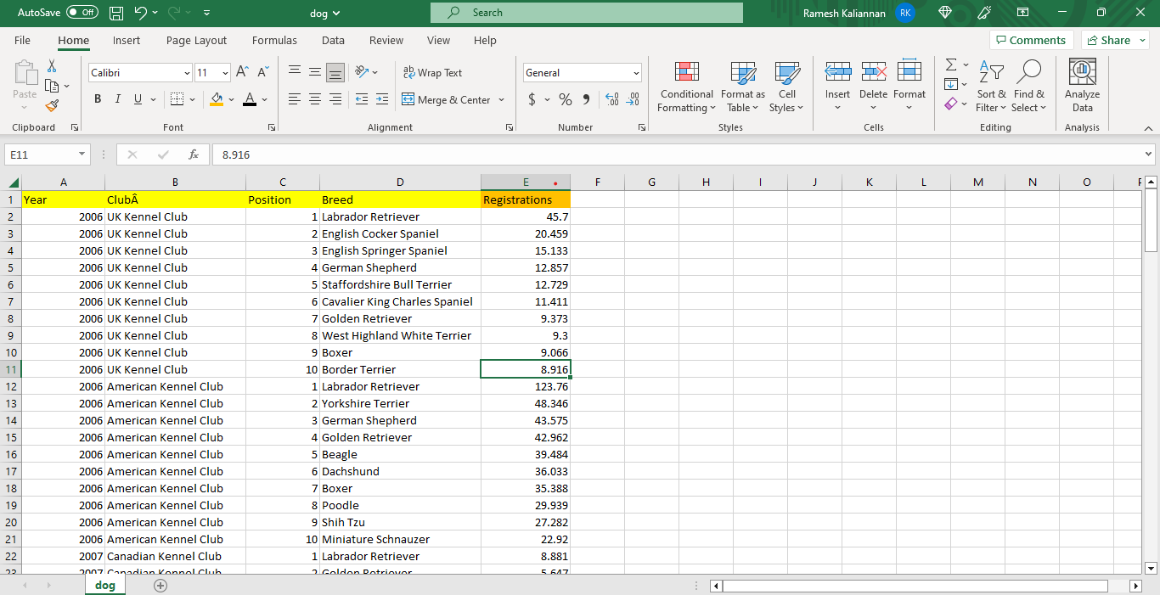
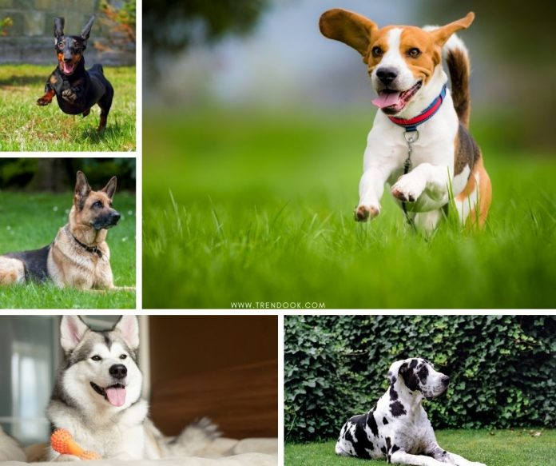
Overview of Dataset :

Slide 7



Slide 8

Percentage :
2006 = 20%
2007 = 30%
2008 = 30%
2009 -2012 = 10%
2013 - 2018 = 30%
2019 = 10%

Slide 9
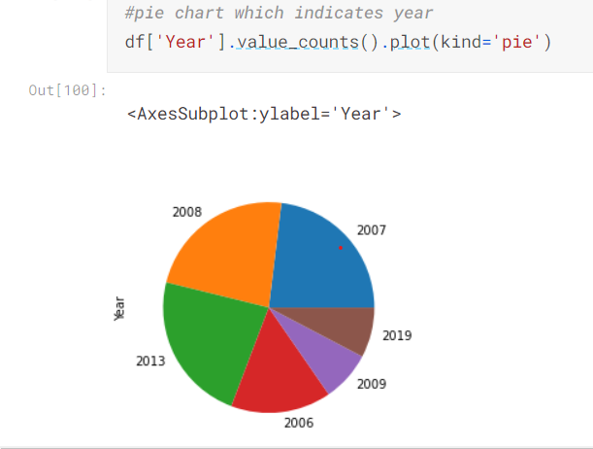
OUTPUT :

Slide 10


